Slide 1
CS 470 Project Two Conference Presentation: Cloud Development
Ron Bal
February 2024

Slide 2
Overview
Introduce yourself.
We will be discussing the migration of a full stack application to a cloud based solution.
Attention: Modify this template to accommodate your content and to reflect your style of communication. You may write a script as notes below each slide and then save the notes as your transcript. Delete this box before submitting.

Slide 3
Containerization
The model we used for this application was containerization, which is the practice of packaging smaller components and processes into their own containers, then deploying them via the cloud.
The necessary tools for this process are container images. Container images are a packaged version of an application and its dependencies.

Slide 4
Orchestration
Docker compose is a resource that allows developers to manage multiple containerized services, streamline development by defining the necessary services with a YAML file, and being able to orchestrate the scaling, upgrades, and deployment of the complete service.

Slide 5
The Serverless Cloud
Serverless
“Serverless” is a cloud computation model where the application is managed by a third party, removing the need to maintain and run your own servers.
S3 storage (Simple Storage Service) is a cloud-based service offered through AWS (Amazon Web Services), which allows users to store and retrieve data from anywhere using a simple web-based interface.

Slide 6
The Serverless Cloud
API & Lambda
A serverless API has numerous advantages such as scalability, cost -effective, reduced operations overhead, high availability, and rapid development and deployment.
Lambda API logic handles API requests and responses. Functions are defined that are triggered by the API Gateway events.
To make all of this happen, we’ll need Lambda functions, API Gateway configurations, request and response templates.
When integrating the frontend with the backend we need to define API endpoints, implement lambda functions, configure an API gateway, secure the endpoints, integrate the frontend to make HTTP requests to the API endpoints defined in the API Gateway, then test and deploy.

Slide 7
The Serverless Cloud
Database
MongoDB is flexible, can be horizontally scaled, can handle large volumes of data, and handle different queries such as key lookups, joins, and aggregations.
DynamoDB provides predictable performance and can seamlessly scale, has low latency, doesn’t need to be managed by users, and has scalable cost.
The queries we performed were: Get an item, scan entire table, update item, delete item, and query a table.
The scripts that need to be produced are Lambda functions, serverless configuration file, API Gateway configurations, request and response templates.

Slide 8
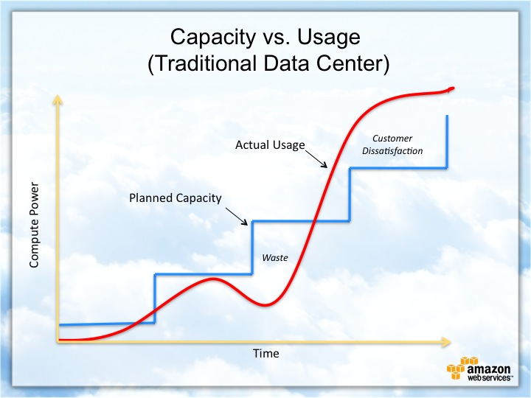
Cloud-Based Development Principles
Elasticity, in a cloud-based envrironment, is the ability to automatically and dynamically scale resources, allowing workloads to be quickly adjusted.
Pay-for-use model is the pricing model where customers pay for only the resources necessary to run their application.

Slide 9
Securing Your Cloud App
Access
Policies
API Security
Unauthorized access to an application can be a few security measures. Keep software and system up-to-date, regular security audits/testing, and strong authentication.
Roles are a defined entity with permissions, assumed by users, services, or external entities, giving temporary permissions to perform actions. Policies are the permissions used to define the allowable actions to roles, users, or groups.
When securing the connection between Lambda and the API Gateway, we can use authorizations or identity and access management.
Securing the Lambda process involves, roles of least privileges, security groups, regular updates and patches, and identity and access management.
To secure your S3 buckets we can use identity and access management, user access control lists, and bucket policies.
Optional: Break this into three separate slides.

Slide 10
Conclusion
Scalability, one of the advantages of cloud development is having the ability to quickly scale resources based on the demand. Developers are able to accommodate usage patterns and traffic changes without being limited by an in-house operation.
Security, it’s important to implement a multi-layered security approach, to protect against things such as data breaches or unauthorized access. This can be done through encryption, role based access control, and or a monitoring tool.
Pay-Per-Use Model, is a model where only the resources necessary to run the application are charged for, creating a cost-effective solution to an application that may not need a ton of resources, but forced to pay for them.
Thank you for your time.

